Slide 1
Secure Data Hiding in Image Using Steganography
AICTE CYBER SECURITY PROJECT
Presented By : Somanath Maharana
Student Name :Somanath Maharana
College name & Department : KMBB College of Engineering And Technology, Computer Science and Engineering

Slide 2
OUTLINE
Problem Statement
Technology used
Wow factor
End users
Result
Conclusion
Git-hub Link
Future scope

Slide 3
Problem Statement
With increasing cyber threats, securing sensitive information is a major concern. Traditional encryption methods are detectable, making data transmission vulnerable. This project leverages steganography to hide data within images, ensuring secure and undetectable communication.

Slide 4
Technology used
Frontend: React.js (GUI) - Hosted on Vercel
Backend: Spring Boot (API)
Image Processing: OpenCV
Programming Languages: Java, JavaScript
Hosting: Vercel (Frontend), Render (Backend)

Slide 5
Wow factors
Secure, undetectable data transmission.
Easy-to-use web interface for encoding & decoding.
No visual alteration in steganographed images.
Open-source and scalable for future improvements.

Slide 6
End users
Cybersecurity professionals
Journalists & whistleblowers
Government & defense agencies
Individuals seeking secure communication

Slide 7
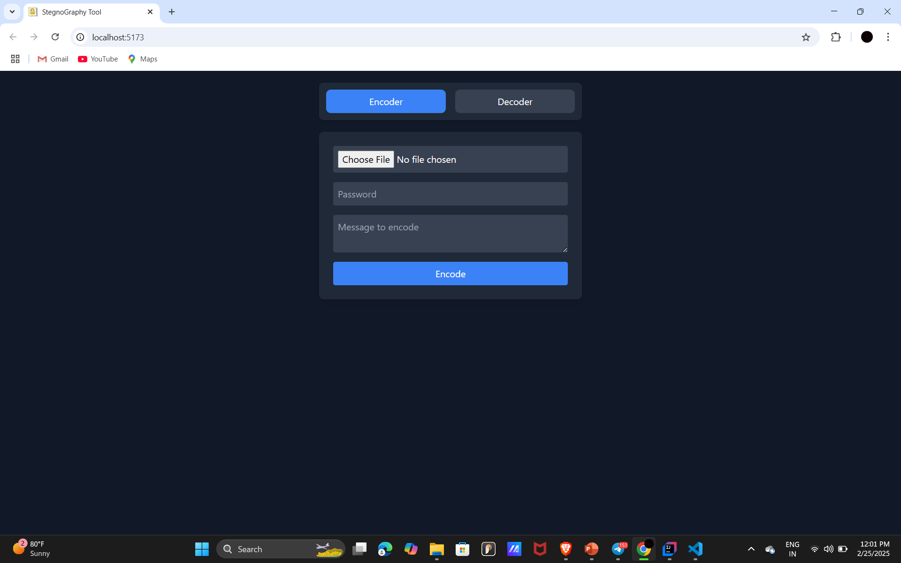
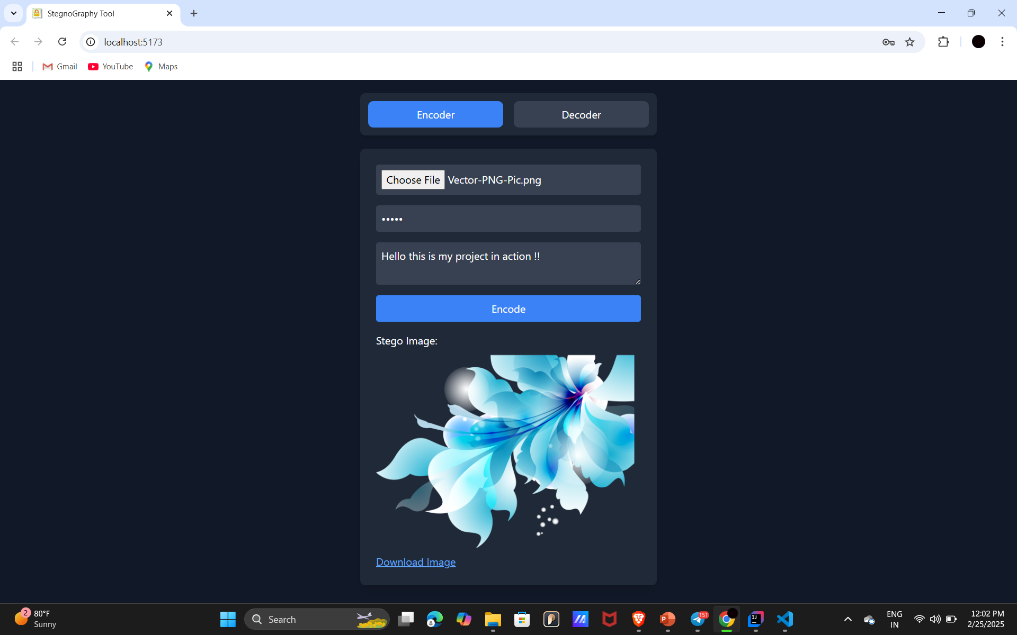
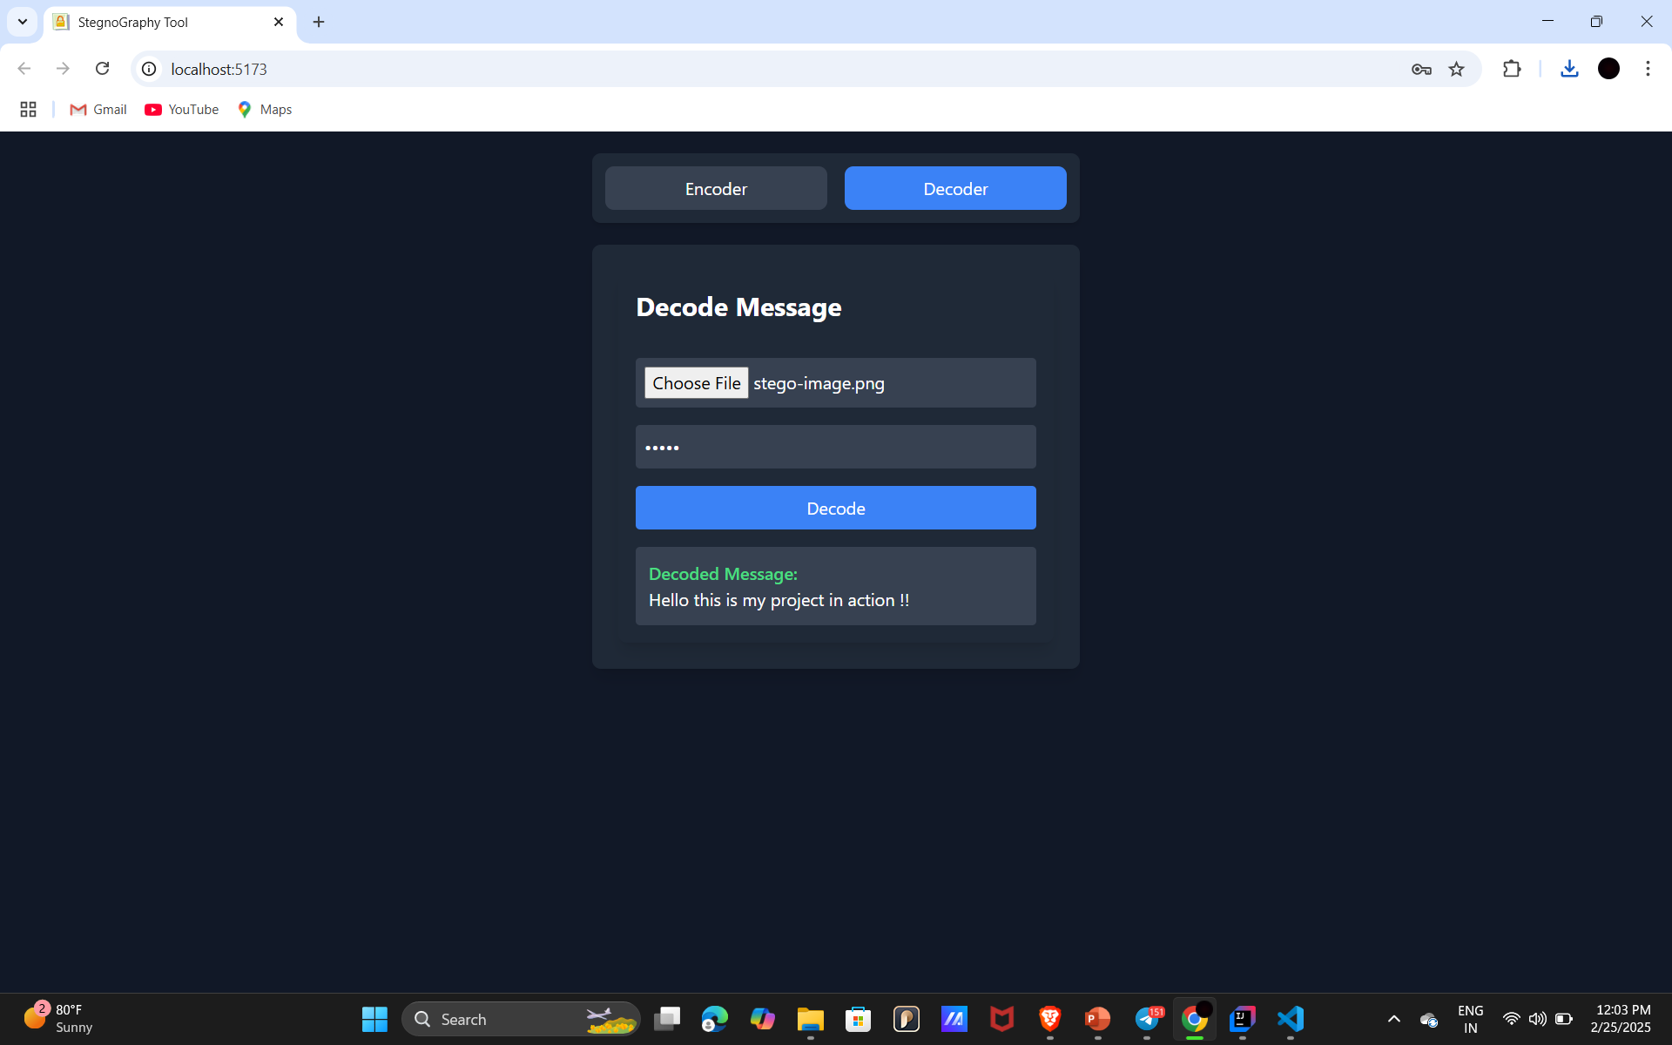
Results
GUI for the project. Made with react.js
Encodes the picture and provides the Stego-Image.
Decodes the provided Stego-Image if the provided password is correct.

Slide 8
Conclusion
Steganography enhances secure data transmission by embedding information within images.
This project demonstrates an efficient method to conceal and extract data, offering a practical cybersecurity solution.

Slide 9
Links
📂 GitHub Repository: AICTE IBM Edunet CyberSecurity Internship Projects
🌐 Live Project Demo: View on Vercel

Slide 10
Future scope
Support for multiple file formats (Audio, Video)
AI-based steganalysis resistance
Improved encryption for added security
Mobile app version for wider accessibility

Slide 11
THANK YOU

